Slide 1
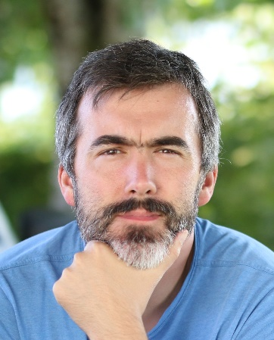
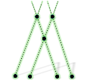
Who am I?
Product owner of the "HPC eXperience“ plateform
Product owner, Software Architect, Lead Dev, …, for the Finite Element Solver
Principal Numerical Scientist HPC
Author of the world class chess engine “Minic”
https://github.com/tryingsomestuff/Minic
https://www.linkedin.com/in/vivien-clauzon-85635638/
https://500px.com/p/xr_a_y?view=photos
I’m passionate about writing high-performance, maintainable scientific codes in answer to modern simulation needs. I’m glad to admit that if it is clearly a technological and technical challenge, it is also an incredibly exciting and rich human adventure. I truly love being part of a team.
Some background
2004-2008 : implementation of HPC simulation code for turbulent compressible fluid flows on vectorial supercomputers (SMAI-GAMNI price)
2008-2011 : implementation of compressible and incompressible interactive fluid flow solvers on GPU
2011-2013 : implementation of resilient and scalable piloting system for meteorological and air quality simulations (Teratec innovation trophy 2016)
Since 2013 : at Michelin ! Noise & comfort, viscoelastic fluid flows. Since 2015 solver team architect, animator, … see current missions above.

